Slide 1

Recursive-Descent Parsing
CS 236
Fall 2023

Slide 2
Recursive Descent Parsing
CS 236
Fall 2023

Slide 3
Overview and Due
Topics
The stack
Recursive descent parsing versus table driven parsing (via parse table)
Each nonterminal gets a method
Code structure
Notes
Flipped class on Wednesday: work on HWs 3c, 4, and 5
Due
HW 3a and 3b due today
HW 3c and 4 due Wednesday
HW 5 due Friday

Slide 4
Stack
A stack is needed to recognize context-free grammars
In table-driven parsing we had an explicit stack that kept track of where we were in the derivation
In recursive-descent parsing, the system takes care of the stack because recursion is implemented with a stack

Slide 5
Review of the Call Stack

Slide 6
Memory Organization in a Computer
High address
Factorial(4)
Push
Recursion uses the stack
def factorial(n: int) -> int:
if n>1:
return n * factorial(n-1)
else:
return 1
Your program
Low address
Operating System Stuff

Slide 7
Memory Organization in a Computer
High address
Factorial(4)
Factorial(3)
Push
Recursion uses the stack
def factorial(n: int) -> int:
if n>1:
return n * factorial(n-1)
else:
return 1
Your program
Low address
Operating System Stuff

Slide 8
Memory Organization in a Computer
High address
Factorial(4)
Factorial(3)
Factorial(2)
Push
Recursion uses the stack
def factorial(n: int) -> int:
if n>1:
return n * factorial(n-1)
else:
return 1
Your program
Low address
Operating System Stuff

Slide 9
Memory Organization in a Computer
High address
Factorial(4)
Factorial(3)
Factorial(2)
Push
Recursion uses the stack
Factorial(1)
def factorial(n: int) -> int:
if n>1:
return n * factorial(n-1)
else:
return 1
Your program
Low address
Operating System Stuff

Slide 10
Memory Organization in a Computer
High address
Factorial(4)
Factorial(3)
Factorial(2)
Pop
1
Recursion uses the stack
Factorial(1)
def factorial(n: int) -> int:
if n>1:
return n * factorial(n-1)
else:
return 1
Your program
Low address
Operating System Stuff

Slide 11
Memory Organization in a Computer
High address
Factorial(4)
Factorial(3)
2
Factorial(2)
Pop
Recursion uses the stack
def factorial(n: int) -> int:
if n>1:
return n * factorial(n-1)
else:
return 1
Your program
Low address
Operating System Stuff

Slide 12
Memory Organization in a Computer
High address
Factorial(4)
6
Factorial(3)
Pop
Recursion uses the stack
def factorial(n: int) -> int:
if n>1:
return n * factorial(n-1)
else:
return 1
Your program
Low address
Operating System Stuff

Slide 13
Memory Organization in a Computer
High address
Factorial(4)
24
Pop
Recursion uses the stack
def factorial(n: int) -> int:
if n>1:
return n * factorial(n-1)
else:
return 1
Your program
Low address
Operating System Stuff

Slide 14
Recursive Descent Parsing
Recursive descent parsing keeps track of both the input stream and the stack
But recursive descent parsing uses recursion so that the operating system manages the stack for us using the call-stack

Slide 15
Recursive Descent Parsing
Recursive descent parsing keeps track of both the input stream and the stack
But recursive descent parsing uses recursion so that the operating system manages the stack for us using the call-stack

Slide 16
Parse Functions
Pattern for parsing nonterminals
Check the current token from our input to match one of the tokens in the FIRST and FOLLOW sets of the nonterminal
This identifies which production to parse next
Call the parse function for each terminal and nonterminal, in order, for the chosen production
Pattern for parsing terminals
Check the current token from our input to make sure it matches the terminal token
Advance to next token in input
Notes:
Any failed check should throw an exception

Slide 17
E → N | OEE O → + | * N → 0 | 1 | 2 | 3
Input Stream T ∪{#}
 | + | * | 0 | 1 | 2 | 3 | #
E | OEE | OEE | N | N | N | N
O | + | *
N |  |  | 0 | 1 | 2 | 3
+ | AdPop
* |  | AdPop
0 |  |  | AdPop
1 |  |  |  | AdPop
2 |  |  |  |  | AdPop
3 |  |  |  |  |  | AdPop
# |  |  |  |  |  |  | accept
Stack V∪{#}

Slide 18
Recursive Descent Parsing – Key Idea
Encode each non-terminal, A, as its own method
“Calling” the non-terminal pushes it onto the stack
Within the method, match terminals generated by A to the input
Checking when the terminals match the input character = AdPop
Within the method, call non-terminals generated by A
Calling the non-terminals pushes them onto the stack
Returning from the method pops the non-terminal from the stack

Slide 19
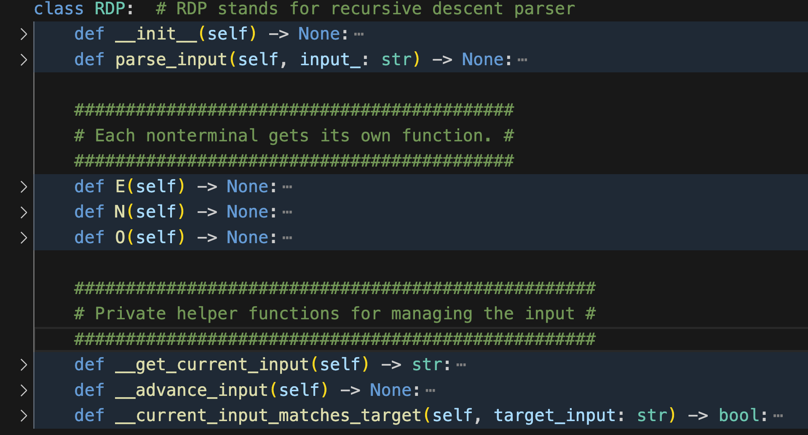
Recursive Descent Parser
E → N | OEE O → + | * N → 0 | 1 | 2 | 3
Notes:
This code is a simplified version of what is in the Jupyter notebook. Simplified to emphasize key elements

Slide 20
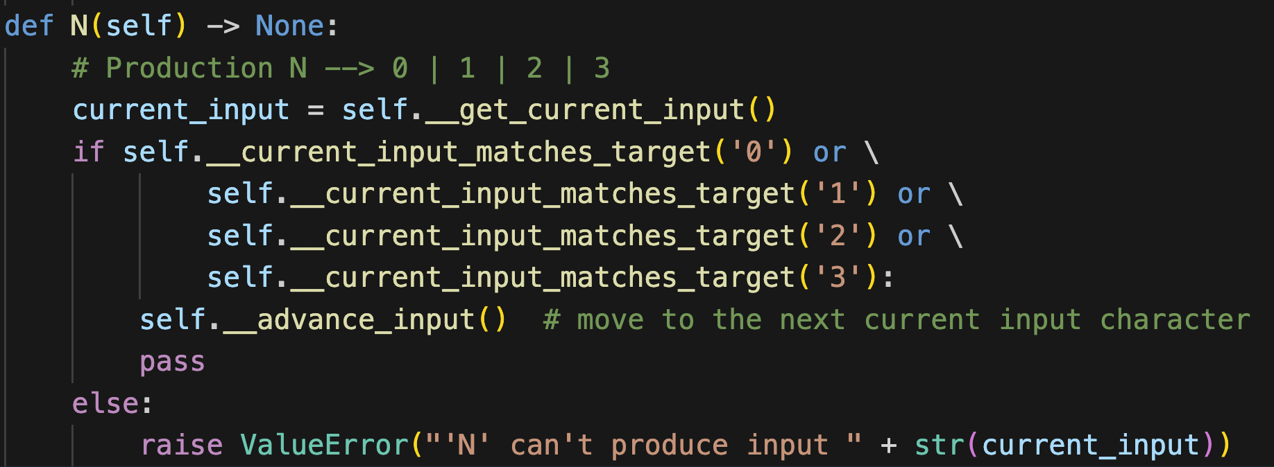
E → N | OEE O → + | * N → 0 | 1 | 2 | 3
Each non-terminal needs a method

Slide 21
E → N | OEE O → + | * N → 0 | 1 | 2 | 3
Each non-terminal needs a method

Slide 22
E → N | OEE O → + | * N → 0 | 1 | 2 | 3
Each non-terminal needs a method

Slide 23
E → N | OEE O → + | * N → 0 | 1 | 2 | 3
Each non-terminal needs a method
AdPop

Slide 24
E → N | OEE O → + | * N → 0 | 1 | 2 | 3
Each non-terminal needs a method
AdPop

Slide 25
E → N | OEE O → + | * N → 0 | 1 | 2 | 3
Each non-terminal needs a method
Raise an error
Prompt: what does “raise” do in Python

Slide 26
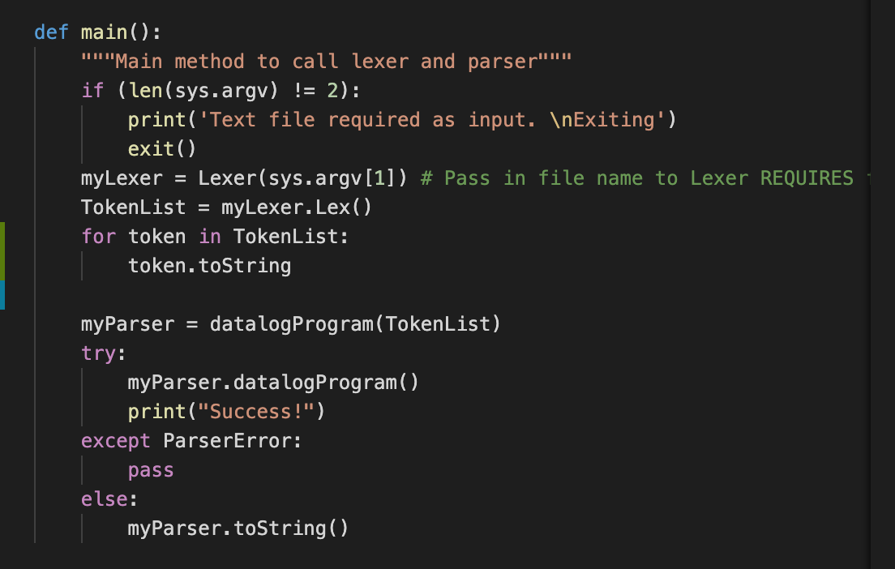
Main
Prompt: what do try and except do in Python

Slide 27
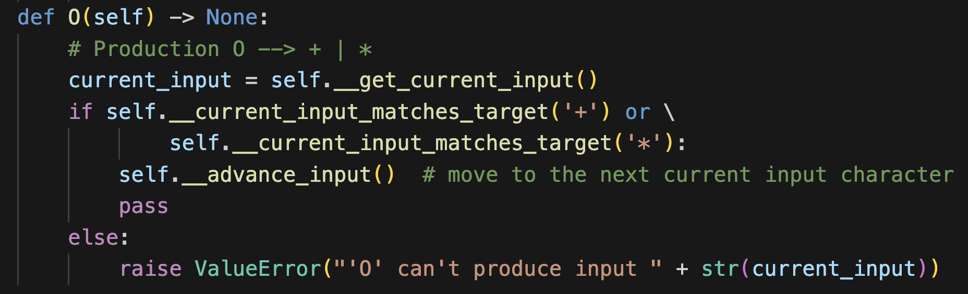
E → N | OEE O → + | * N → 0 | 1 | 2 | 3
Each non-terminal needs a method

Slide 28
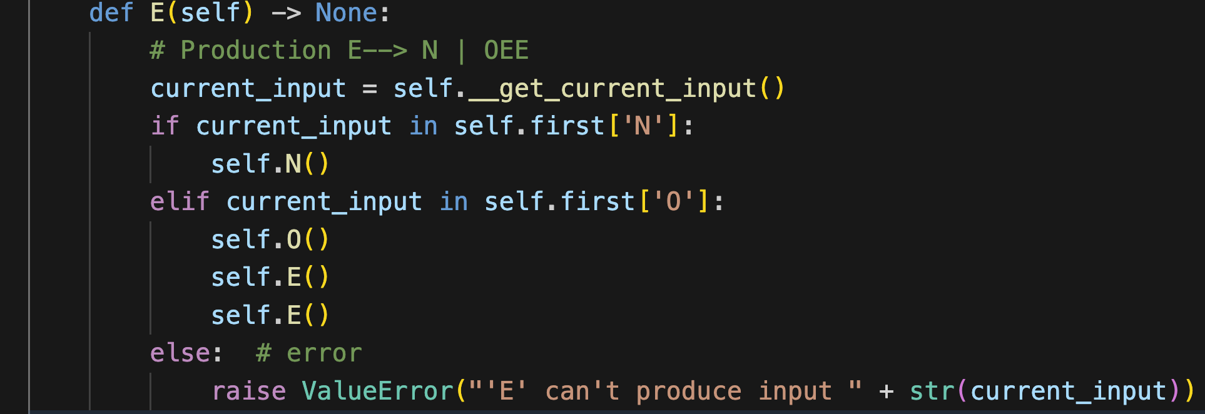
E → N | OEE O → + | * N → 0 | 1 | 2 | 3
Each non-terminal needs a method
FIRST set of N

Slide 29
E → N | OEE O → + | * N → 0 | 1 | 2 | 3
Each non-terminal needs a method
FIRST set of OEE

Slide 30
E → N | OEE O → + | * N → 0 | 1 | 2 | 3
Each non-terminal needs a method
FIRST set of OEE
then call OEE

Slide 31
E → N | OEE O → + | * N → 0 | 1 | 2 | 3
Input Stream T ∪{#}
 | + | * | 0 | 1 | 2 | 3 | #
E | OEE | OEE | N | N | N | N
O | + | *
N |  |  | 0 | 1 | 2 | 3
+ | AdPop
* |  | AdPop
0 |  |  | AdPop
1 |  |  |  | AdPop
2 |  |  |  |  | AdPop
3 |  |  |  |  |  | AdPop
# |  |  |  |  |  |  | accept
Stack V∪{#}

Slide 32
From Parse Table to Recursion

Slide 33
Recursive Descent Parsing – Key Idea
Each non-terminal A has a method
N -> 0 | 1 | 2 | 3
Match(currentInput,’0’)
if currentInput in FIRST(OEE) then O(currentInput)
else error
currentInput == ‘0' return true
else error
E -> OEE | N
Non-terminal on the RHS

Slide 34
E → N | OEE O → + | * N → 0 | 1 | 2 | 3
Input
+*231
Call stack
main calls E(input)

Slide 35
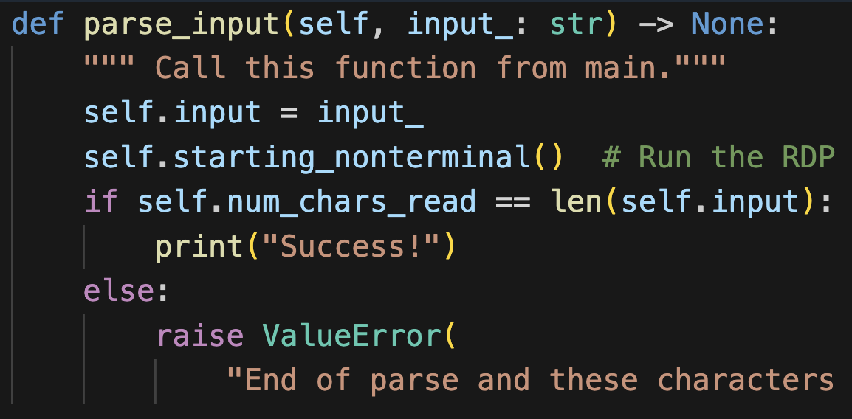
E → N | OEE O → + | * N → 0 | 1 | 2 | 3
Input
+*231
Run the RDP by
calling E
Call stack
main calls E(input)

Slide 36
E → N | OEE O → + | * N → 0 | 1 | 2 | 3
Input
+*231
Which pushes E
onto the stack
Call stack
E(input)
main calls E(input)

Slide 37
Recursive Descent Parsing – Key Idea
Each non-terminal A has a method
N -> 0 | 1 | 2 | 3
Match(currentInput,’0’)
E -> OEE | N
if currentInput in FIRST(OEE) then O(currentInput)
else error
currentInput == ‘0' return true
else error
Non-terminal on the RHS

Slide 38
E → N | OEE O → + | * N → 0 | 1 | 2 | 3
Input
+*231
Run E
Call stack
E(input)
main calls E(input)

Slide 39
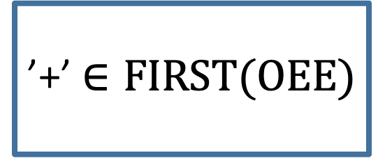
E → N | OEE O → + | * N → 0 | 1 | 2 | 3
Input
’+’ $∈FIRST(OEE)$
+*231
Call stack
E(input)
main calls E(input)

Slide 40
E → N | OEE O → + | * N → 0 | 1 | 2 | 3
Input
’+’ $∈FIRST(OEE)$
+*231
Call stack
E(input)
 | + | * | 0 | 1 | 2 | 3 | #
E | OEE | OEE | N | N | N | N
O | + | *
N |  |  | 0 | 1 | 2 | 3
+ | AdPop
* |  | AdPop
0 |  |  | AdPop
1 |  |  |  | AdPop
2 |  |  |  |  | AdPop
3 |  |  |  |  |  | AdPop
# |  |  |  |  |  |  | accept
main calls E(input)

Slide 41
E → N | OEE O → + | * N → 0 | 1 | 2 | 3
Input
Call O
Which pushes O to the stack
+*231
Call stack
E(input)
O(input)
main calls E(input)

Slide 42
Recursive Descent Parsing – Key Idea
Each non-terminal A has a method
N -> 0 | 1 | 2 | 3
Match(currentInput,’0’)
E -> OEE | N
if currentInput in FIRST(OEE) then O(currentInput)
else error
currentInput == ‘0' return true
else error
Non-terminal on the RHS

Slide 43
E → N | OEE O → + | * N → 0 | 1 | 2 | 3
Input
Run O
+*231
Call stack
E(input)
O(input)
main calls E(input)

Slide 44
E → N | OEE O → + | * N → 0 | 1 | 2 | 3
Input
Run O
+*231
Call stack
E(input)
 | + | * | 0 | 1 | 2 | 3 | #
E | OEE | OEE | N | N | N | N
O | + | *
N |  |  | 0 | 1 | 2 | 3
+ | AdPop
* |  | AdPop
0 |  |  | AdPop
1 |  |  |  | AdPop
2 |  |  |  |  | AdPop
3 |  |  |  |  |  | AdPop
# |  |  |  |  |  |  | accept
O(input)
main calls E(input)

Slide 45
E → N | OEE O → + | * N → 0 | 1 | 2 | 3
Input
AdPop
+*231
Call stack
E(input)
 | + | * | 0 | 1 | 2 | 3 | #
E | OEE | OEE | N | N | N | N
O | + | *
N |  |  | 0 | 1 | 2 | 3
+ | AdPop
* |  | AdPop
0 |  |  | AdPop
1 |  |  |  | AdPop
2 |  |  |  |  | AdPop
3 |  |  |  |  |  | AdPop
# |  |  |  |  |  |  | accept
O(input)
main calls E(input)

Slide 46
E → N | OEE O → + | * N → 0 | 1 | 2 | 3
Input
Match
+*231
Call stack
E(input)
O(input)
main calls E(input)

Slide 47
E → N | OEE O → + | * N → 0 | 1 | 2 | 3
Input
AdPop
+*231
Call stack
E(input)
O(input)
main calls E(input)

Slide 48
E → N | OEE O → + | * N → 0 | 1 | 2 | 3
Input
AdPop
+*231
Call stack
E(input)
O(input)
main calls E(input)

Slide 49
E → N | OEE O → + | * N → 0 | 1 | 2 | 3
Input
AdPop
+*231
Call stack
E(input)
O(input)
main calls E(input)

Slide 50
E → N | OEE O → + | * N → 0 | 1 | 2 | 3
Input
AdPop
+*231
Call stack
E(input)
main calls E(input)

Slide 51
E → N | OEE O → + | * N → 0 | 1 | 2 | 3
Input
Return to E
+*231
Call stack
E(input)
main calls E(input)

Slide 52
E → N | OEE O → + | * N → 0 | 1 | 2 | 3
Input
We already ran O
+*231
Call stack
E(input)
main calls E(input)

Slide 53
E → N | OEE O → + | * N → 0 | 1 | 2 | 3
Input
call the next E
+*231
Call stack
E(input)
main calls E(input)

Slide 54
E → N | OEE O → + | * N → 0 | 1 | 2 | 3
Input
which pushes E onto the stack
+*231
Call stack
E(input)
E(input)
main calls E(input)

Slide 55
E → N | OEE O → + | * N → 0 | 1 | 2 | 3
Input
In new copy of the E
+*231
Call stack
E(input)
E(input)
main calls E(input)

Slide 56
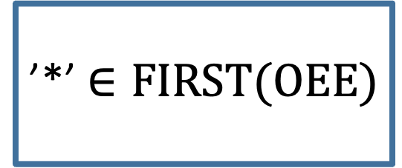
E → N | OEE O → + | * N → 0 | 1 | 2 | 3
Input
’*’ $∈FIRST(OEE)$
+*231
Call stack
E(input)
E(input)
main calls E(input)

Slide 57
E → N | OEE O → + | * N → 0 | 1 | 2 | 3
Input
Run O
+*231
Call stack
E(input)
E(input)
O(input)
main calls E(input)

Slide 58
E → N | OEE O → + | * N → 0 | 1 | 2 | 3
Input
Match *
+*231
Call stack
E(input)
E(input)
O(input)
main calls E(input)

Slide 59
E → N | OEE O → + | * N → 0 | 1 | 2 | 3
Input
Match *
+*231
Call stack
E(input)
E(input)
O(input)
main calls E(input)

Slide 60
E → N | OEE O → + | * N → 0 | 1 | 2 | 3
Input
AdPop
+*231
Call stack
E(input)
E(input)
O(input)
main calls E(input)

Slide 61
E → N | OEE O → + | * N → 0 | 1 | 2 | 3
Input
AdPop
+*231
Call stack
E(input)
E(input)
main calls E(input)

Slide 62
E → N | OEE O → + | * N → 0 | 1 | 2 | 3
Input
Return to E
Call next E
+*231
Call stack
E(input)
E(input)
E(input)
main calls E(input)

Slide 63
Application to Project 2

Slide 64
Main

Slide 65
Datalog Grammar (partial), from https://learningsuite.byu.edu/.Z3FE/cid-I4ezssz0M_oT/pages/id-ssbw
datalogProgram -> SCHEMES COLON scheme schemeList FACTS COLON factList RULES COLON ruleList QUERIES COLON query queryList
schemeList -> scheme schemeList | lambda
factList -> fact factList | lambda
ruleList -> rule ruleList | lambda
queryList -> query queryList | lambda
scheme -> ID LEFT_PAREN ID idList RIGHT_PAREN
fact -> ID LEFT_PAREN STRING stringList RIGHT_PAREN PERIOD
rule -> headPredicate COLON_DASH predicate predicateList PERIOD
query -> predicate Q_MARK
…

Slide 66
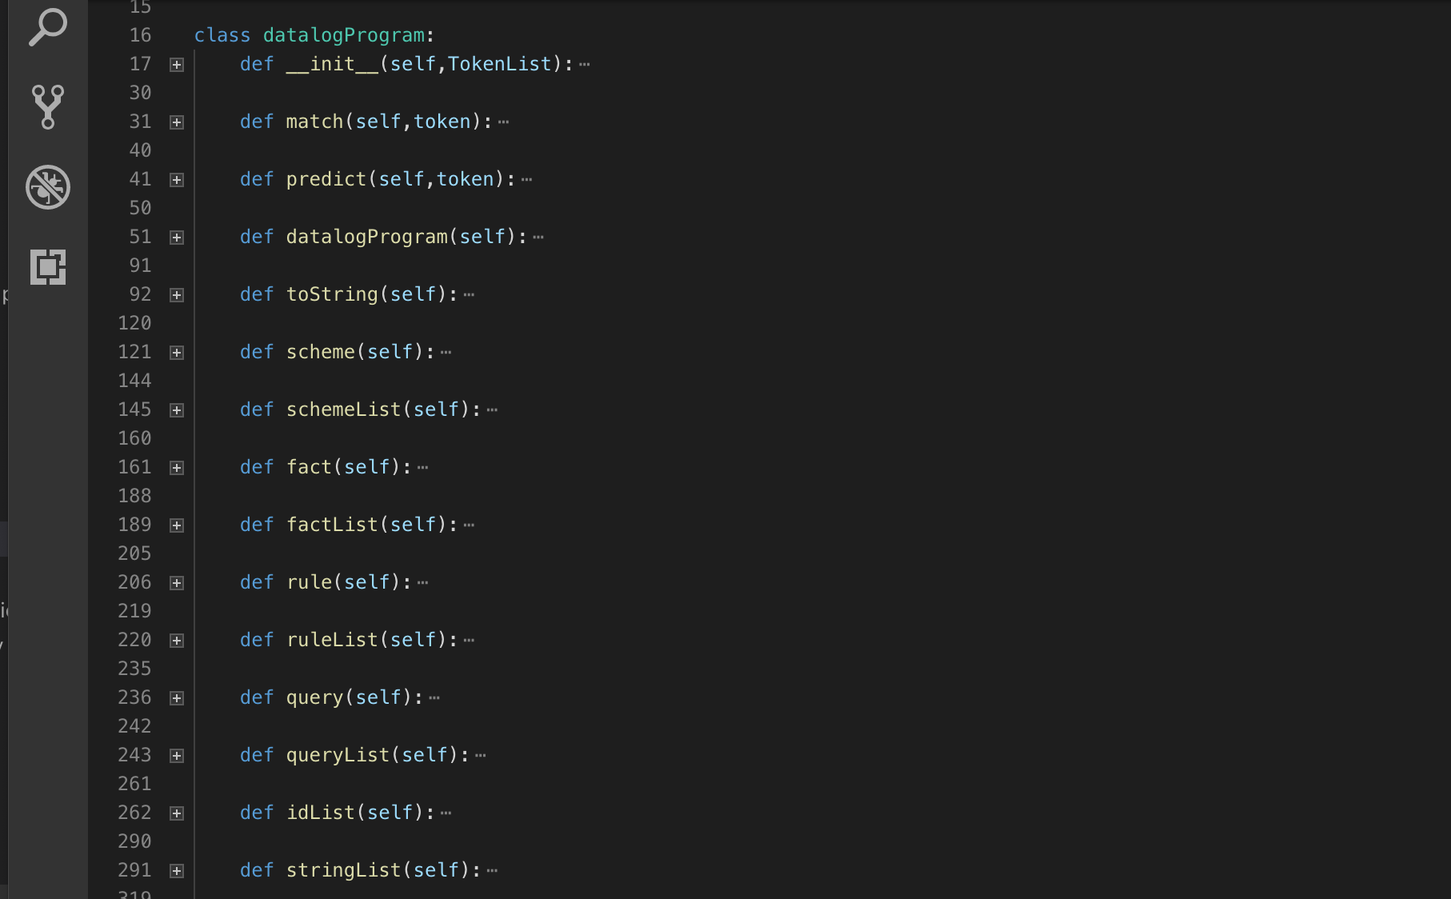
My Python Parser

Slide 67
My Python Parser
datalogProgram -> SCHEMES COLON scheme schemeList FACTS COLON factList RULES COLON ruleList QUERIES COLON query queryList
schemeList -> scheme schemeList | lambda
factList -> fact factList | lambda
ruleList -> rule ruleList | lambda
queryList -> query queryList | lambda
scheme -> ID LEFT_PAREN ID idList RIGHT_PAREN
fact -> ID LEFT_PAREN STRING stringList RIGHT_PAREN PERIOD
rule -> headPredicate COLON_DASH predicate predicateList PERIOD
query -> predicate Q_MARK
…

Slide 68
My Python Parser
Each non-terminal has a method
datalogProgram -> SCHEMES COLON scheme schemeList FACTS COLON factList RULES COLON ruleList QUERIES COLON query queryList
schemeList -> scheme schemeList | lambda
factList -> fact factList | lambda
ruleList -> rule ruleList | lambda
queryList -> query queryList | lambda
scheme -> ID LEFT_PAREN ID idList RIGHT_PAREN
fact -> ID LEFT_PAREN STRING stringList RIGHT_PAREN PERIOD
rule -> headPredicate COLON_DASH predicate predicateList PERIOD
query -> predicate Q_MARK
…

Slide 69
Main

Slide 70
Datalog Grammar (partial) from Project 2 description
datalogProgram -> SCHEMES COLON scheme schemeList FACTS COLON factList RULES COLON ruleList QUERIES COLON query queryList
schemeList -> scheme schemeList | lambda
factList -> fact factList | lambda
ruleList -> rule ruleList | lambda
queryList -> query queryList | lambda
scheme -> ID LEFT_PAREN ID idList RIGHT_PAREN
fact -> ID LEFT_PAREN STRING stringList RIGHT_PAREN PERIOD
rule -> headPredicate COLON_DASH predicate predicateList PERIOD
query -> predicate Q_MARK
…

Slide 71
My Python Parser

Slide 72
My Python Parser
datalogProgram -> SCHEMES COLON scheme schemeList FACTS COLON factList RULES COLON ruleList QUERIES COLON query queryList
schemeList -> scheme schemeList | lambda
factList -> fact factList | lambda
ruleList -> rule ruleList | lambda
queryList -> query queryList | lambda
scheme -> ID LEFT_PAREN ID idList RIGHT_PAREN
fact -> ID LEFT_PAREN STRING stringList RIGHT_PAREN PERIOD
rule -> headPredicate COLON_DASH predicate predicateList PERIOD
query -> predicate Q_MARK
…

Slide 73
My Python Parser
Each non-terminal has a method
datalogProgram -> SCHEMES COLON scheme schemeList FACTS COLON factList RULES COLON ruleList QUERIES COLON query queryList
schemeList -> scheme schemeList | lambda
factList -> fact factList | lambda
ruleList -> rule ruleList | lambda
queryList -> query queryList | lambda
scheme -> ID LEFT_PAREN ID idList RIGHT_PAREN
fact -> ID LEFT_PAREN STRING stringList RIGHT_PAREN PERIOD
rule -> headPredicate COLON_DASH predicate predicateList PERIOD
query -> predicate Q_MARK
…

Slide 74
My Python Parser
Each non-terminal has a method
datalogProgram -> SCHEMES COLON scheme schemeList FACTS COLON factList RULES COLON ruleList QUERIES COLON query queryList
schemeList -> scheme schemeList | lambda
factList -> fact factList | lambda
ruleList -> rule ruleList | lambda
queryList -> query queryList | lambda
scheme -> ID LEFT_PAREN ID idList RIGHT_PAREN
fact -> ID LEFT_PAREN STRING stringList RIGHT_PAREN PERIOD
rule -> headPredicate COLON_DASH predicate predicateList PERIOD
query -> predicate Q_MARK
…

Slide 75
A Complete Datalog Program
Schemes:
A(C)
Facts:
Rules:
Queries:
A(b1)?

Slide 76
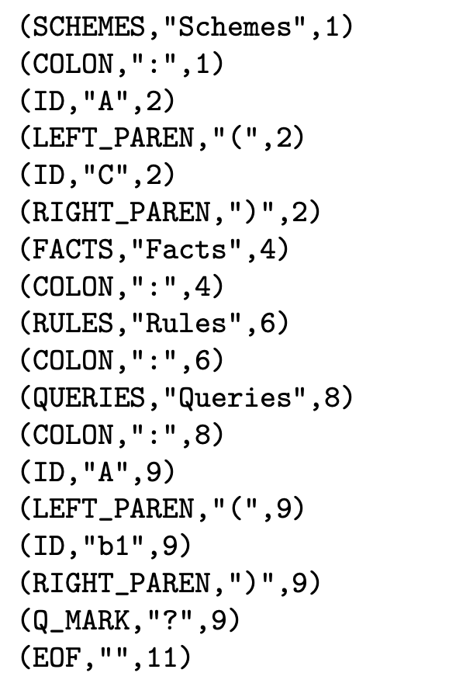
A Complete Datalog Program
Schemes:
A(C)
Facts:
Rules:
Queries:
A(b1)?
This is the
input stream

Slide 77
Trace
Stack
Input
Datalog()

Slide 78
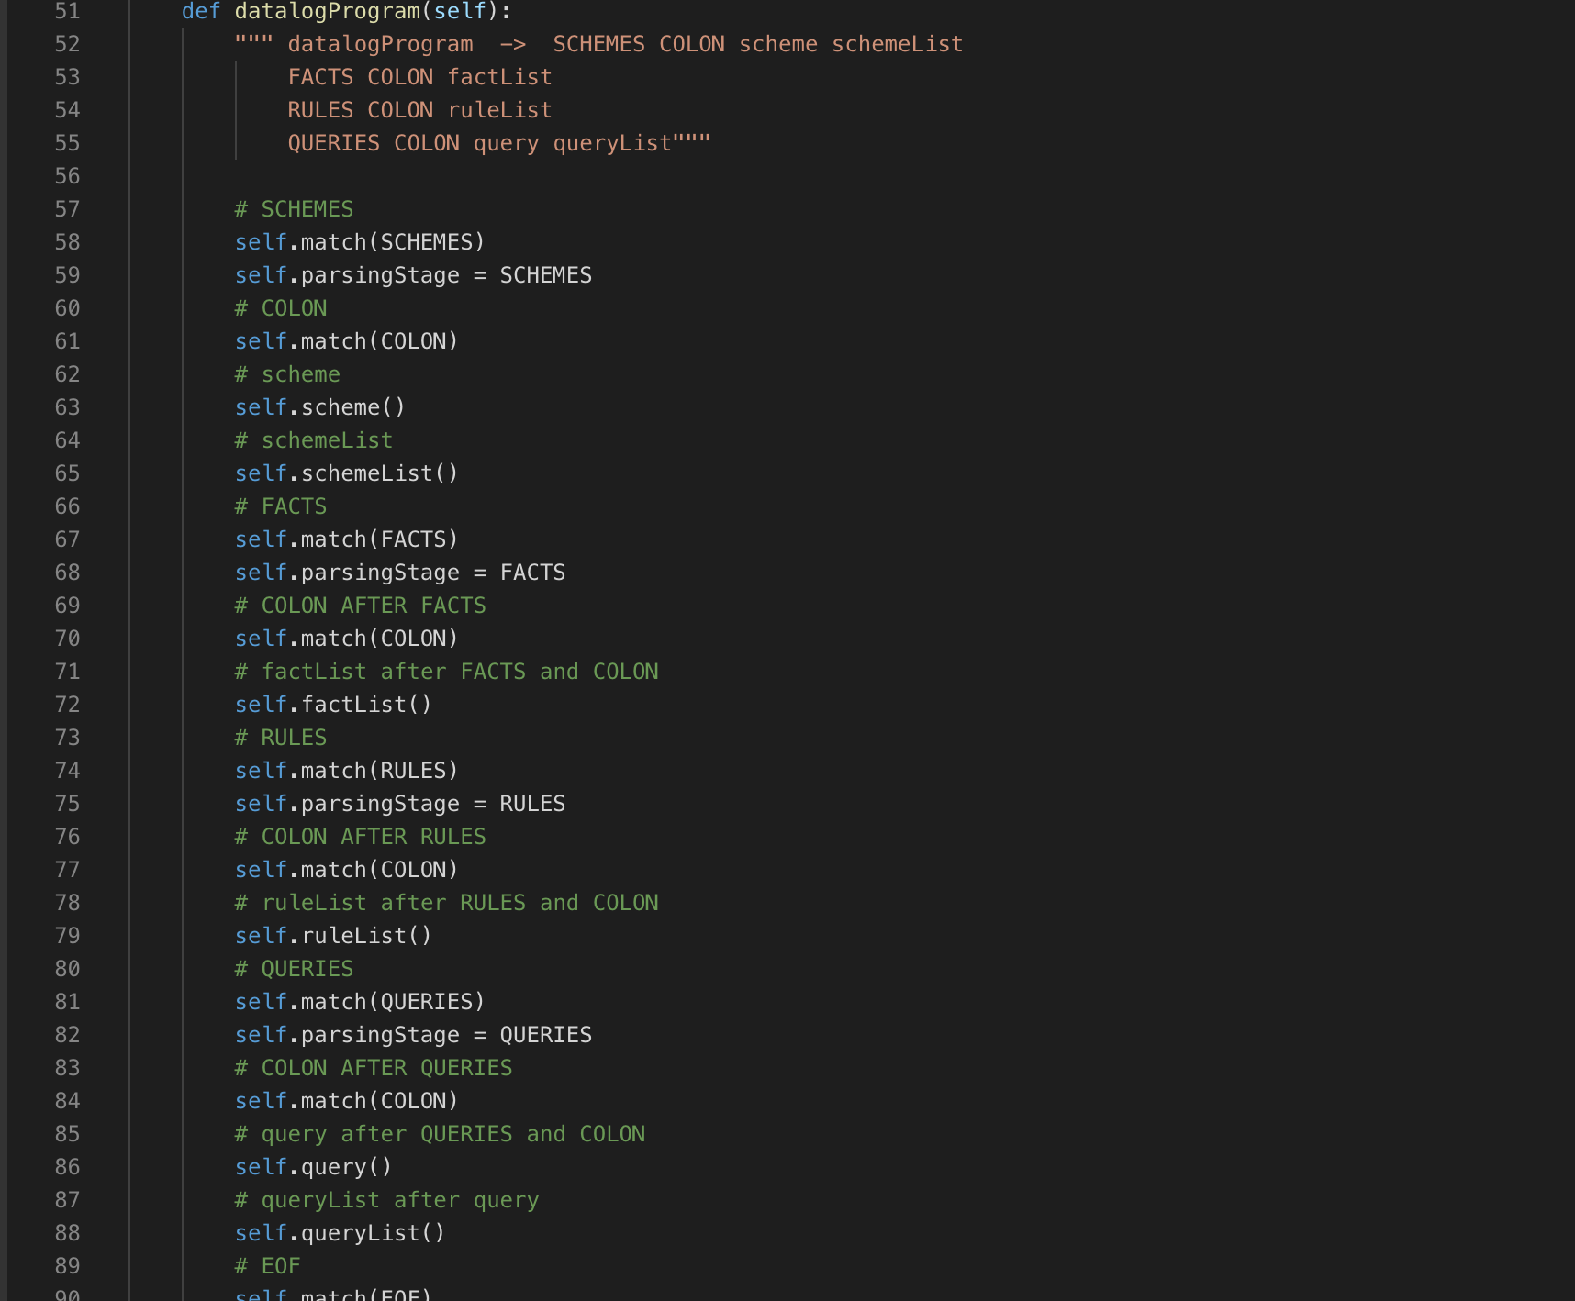
Trace
Stack
Input
Datalog()

Slide 79
Trace
Stack
Input
Datalog()

Slide 80
Trace
Stack
Input
Datalog()

Slide 81
Trace
Stack
Input
Datalog()
scheme()

Slide 82
Trace
Stack
Input
Datalog()
scheme()
Skipping what
happens in
scheme

Slide 83
Trace
Stack
Input
Datalog()
scheme()
Skipping what
happens in
scheme

Slide 84
Trace
Stack
Input
Datalog()
Skipping what
happens in
scheme

Slide 85
Trace
Stack
Input
Datalog()

Slide 86
Trace
Stack
Input
Datalog()
schemeList()

Slide 87
Interlude: What about FOLLOW Sets?

Slide 88
new grammar E → nDI | OEE I → DI | λ O → + | * D → 0 | 1 | 2 | 3
New grammar:
Allow two digit arithmetic
+n12n100
Notes:
Jupyter notebook on recursive descent parsing with FOLLOW sets

Slide 89
new grammar E → nDI | OEE I → DI | λ O → + | * D → 0 | 1 | 2 | 3
New grammar:
Allow two digit arithmetic
old grammar
E → N | OEE O → + | * N → 0 | 1 | 2 | 3

Slide 90
new grammar E → nDI | OEE I → DI | λ O → + | * D → 0 | 1 | 2 | 3
New grammar:
FIRST sets of non-terminals
FIRST(nDI) = {n}
FIRST(OEE) = {+,*}
FIRST(DI) = {0,1,2,3}
FIRST(D) = {0,1,2,3}
Notes:
Jupyter notebook on recursive descent parsing with FOLLOW sets

Slide 91
new grammar E → nDI | OEE I → DI | λ O → + | * D → 0 | 1 | 2 | 3
New grammar:
FOLLOW sets of non-terminals
tail recursion requires follow sets
Notes:
Jupyter notebook on recursive descent parsing with FOLLOW sets

Slide 92
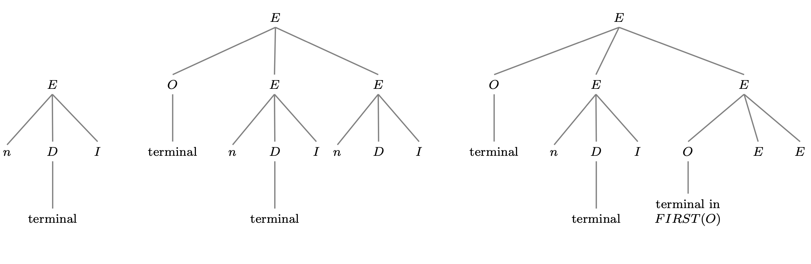
new grammar E → nDI | OEE I → DI | λ O → + | * D → 0 | 1 | 2 | 3
New grammar:
FOLLOW sets of non-terminals
FOLLOW(I) = {#,n,+,*}
where # is end of string character
Notes:
Jupyter notebook on recursive descent parsing with FOLLOW sets

Slide 93
new grammar E → nDI | OEE I → DI | λ O → + | * D → 0 | 1 | 2 | 3
New grammar:
FOLLOW sets of non-terminals
FOLLOW(I) = {#,n,+,*}
where # is end of string character
Notes:
Jupyter notebook on recursive descent parsing with FOLLOW sets

Slide 94
new grammar E → nDI | OEE I → DI | λ O → + | * D → 0 | 1 | 2 | 3
New grammar:
FOLLOW sets of non-terminals
FOLLOW(I) = {#,n,+,*}
where # is end of string character
Notes:
Jupyter notebook on recursive descent parsing with FOLLOW sets

Slide 95
new grammar E → nDI | OEE I → DI | λ O → + | * D → 0 | 1 | 2 | 3
New grammar:
FOLLOW sets of non-terminals
FOLLOW(I) = {#,n,+,*}
where # is end of string character
Notes:
Jupyter notebook on recursive descent parsing with FOLLOW sets

Slide 96
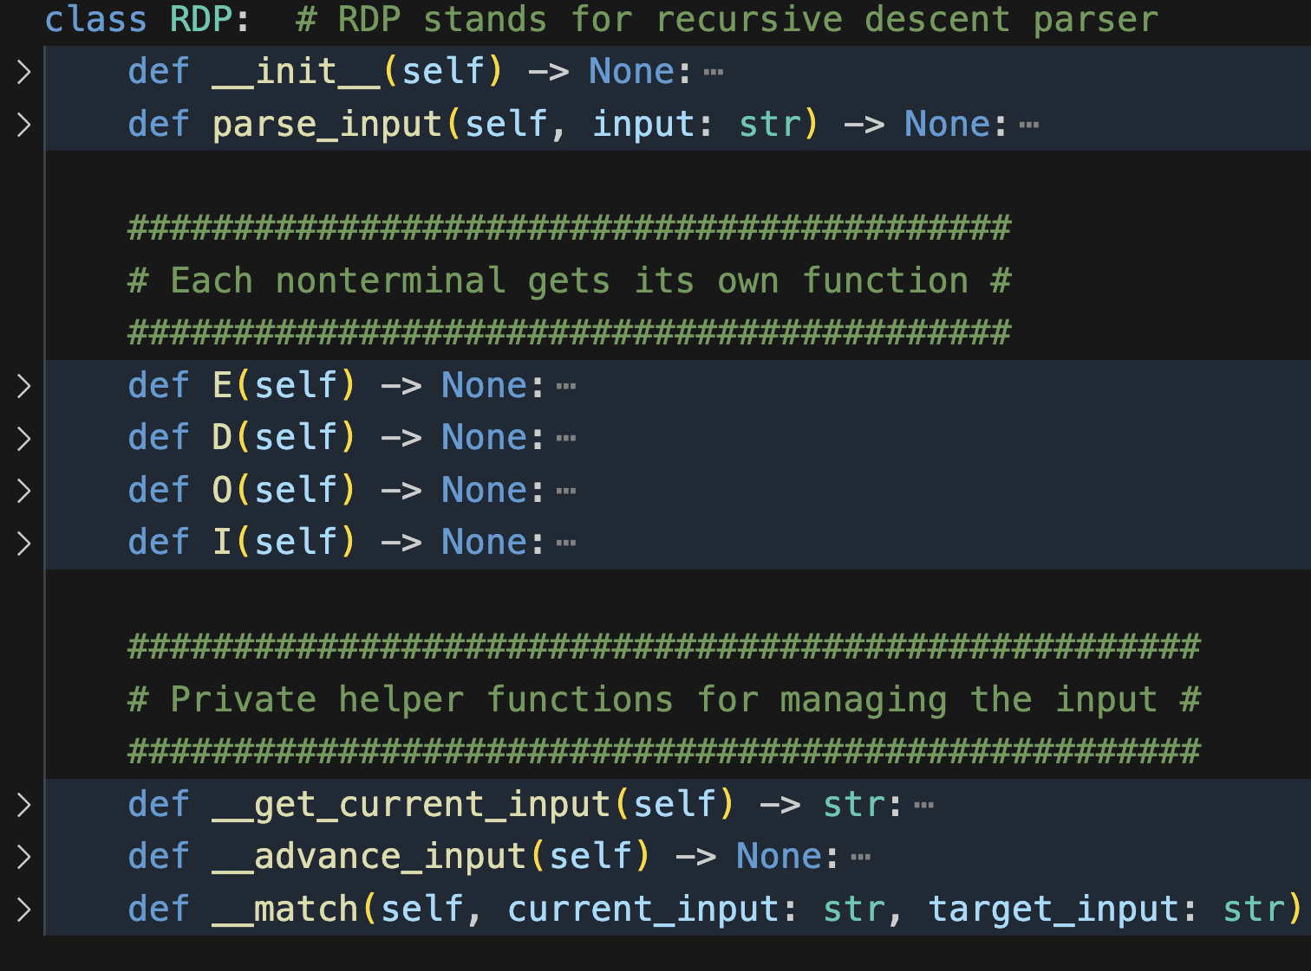
new grammar E → nDI | OEE I → DI | λ O → + | * D → 0 | 1 | 2 | 3
Recursive descent parser for new grammar
FIRST(nDI) = {n}
FIRST(OEE) = {+,*}
FIRST(DI) = {0,1,2,3}
FIRST(D) = {0,1,2,3}
FOLLOW(I) = {#,n,+,*}
Notes:
Jupyter notebook on recursive descent parsing with FOLLOW sets

Slide 97
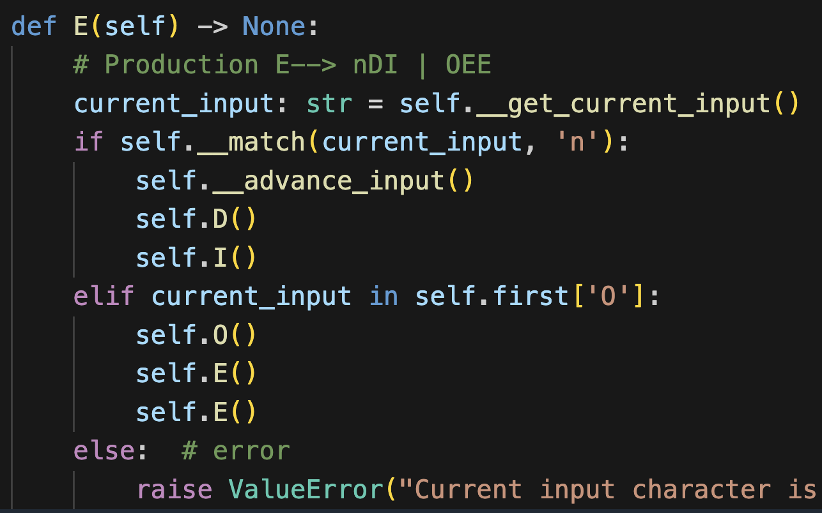
E → nDI | OEE I → DI | λ O → + | * D → 0 | 1 | 2 | 3
FIRST(nDI) = {n}
FIRST(OEE) = {+,*}

Slide 98
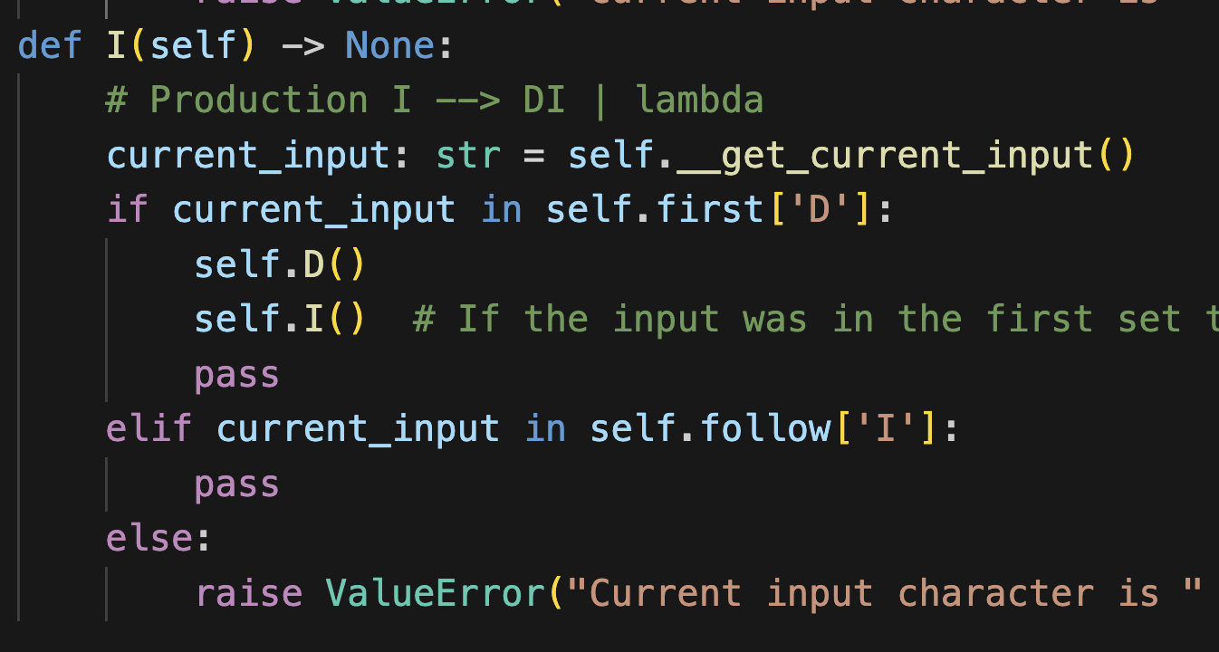
E → nDI | OEE I → DI | λ O → + | * D → 0 | 1 | 2 | 3
FIRST(DI) = {0,1,2,3}
FOLLOW(I) = {#,n,+,*}

Slide 99
E → nDI | OEE I → DI | λ O → + | * D → 0 | 1 | 2 | 3
FIRST(DI) = {0,1,2,3}
FOLLOW(I) = {#,n,+,*}

Slide 100
E → nDI | OEE I → DI | λ O → + | * D → 0 | 1 | 2 | 3
FIRST(DI) = {0,1,2,3}
FOLLOW(I) = {#,n,+,*}

Slide 101
Returning to Project 2 Example

Slide 102
Trace
Stack
Input
Datalog()
schemeList()
FACTS ∈ FOLLOW(schemeList)
Use lambda production

Slide 103
Trace
Stack
Input
Datalog()
FACTS ∈ FOLLOW(schemeList)
Use lambda production

Slide 104
Trace
Stack
Input
Datalog()

Slide 105
Trace
Stack
Input
Datalog()

Slide 106
Trace
Stack
Input
Datalog()
factList()

Slide 107
Trace
Stack
Input
Datalog()
factList()

Slide 108
Trace
Stack
Input
Datalog()
factList()

Slide 109
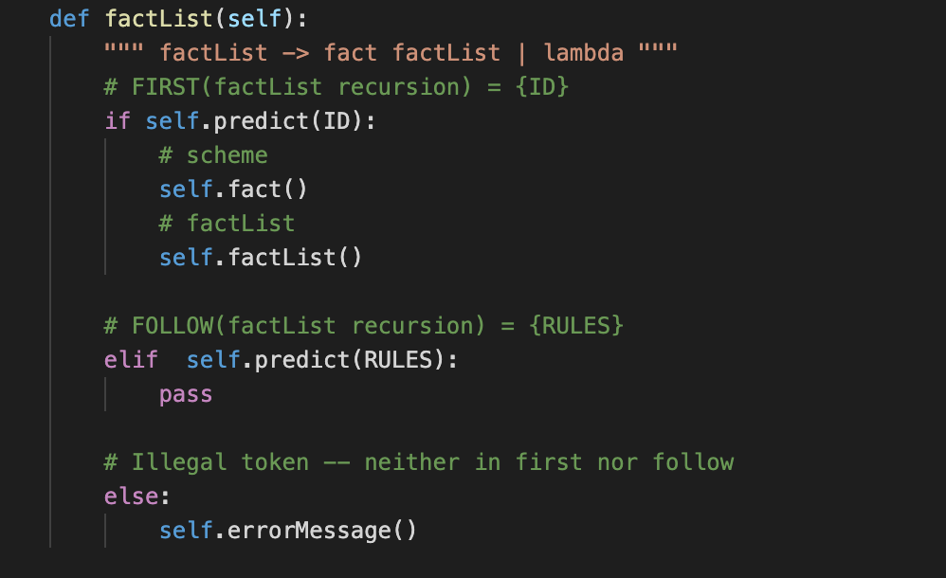
Trace
Stack
Input
Datalog()
factList()

Slide 110
Trace
Stack
Input
Datalog()
factList()
RULES ∈ FOLLOW(factList)
Use lambda production

Slide 111
Trace
Stack
Input
Datalog()
RULES ∈ FOLLOW(factList)
Use lambda production

Slide 112
Trace
Stack
Input
Datalog()

Slide 113
Trace
Stack
Input
Datalog()

